Slide 1
Extracting Insights from Amazon.com Customer Reviews
Ryan Burakowski
NYC Data Science Academy
May 24th, 2021

Slide 2
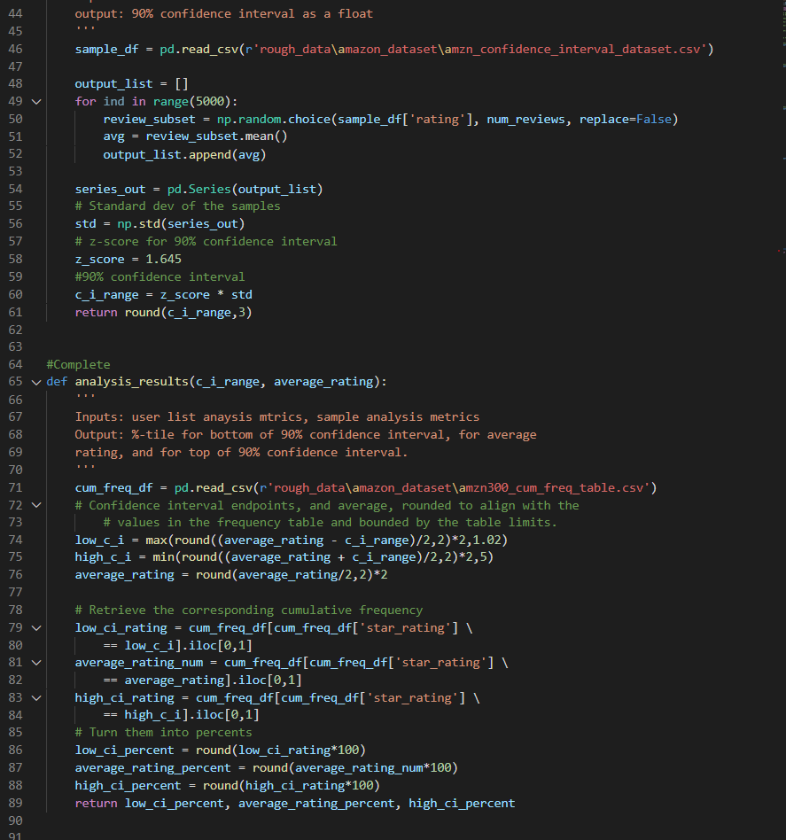
Project Statement
Analyze the distribution characteristics of online reviews, at the product/service level.
Investigate how many reviews a product/service needs to be meaningful.
Build a tool to help businesses extract meaning from the customer reviews of their products/services
Narrowing the scope to focus on the world’s largest online retail marketplace, Amazon.com.

Slide 3
Agenda
1. The Problem
2. Data & Analysis
How to find meaning in online customer reviews?
Source of data. Analysis to conduct.
3. Project Results
4. Tool Demonstration
5. Future Work / Q&A
Results of analysis and why they are important.
Bringing it all together for a purpose.
Extensibility. Additional analysis.

Slide 4
The Problem
What do Online Customer Ratings Really Tell Us?
How can Companies Use Online Review Information?
How to Gain Actual Insight?
3 / 5 Stars is not ‘average’
Amazon
Airbnb
Yelp
Seamless
Known selection bias issues with self-reporting data.
What to do with this biased / skewed data?
Calculating a number is easy:
Does it have meaning?
Is it robust?
Is it statistically significant?

Slide 5
Background: Online Customer Reviews
Biases
Distribution
Prior Research
Polarity self-selection
Purchase self-selection
High level of polarity
Large positive imbalance
On user-level, depend on number of reviews written
On platform level, affected by scale ratings, social networking aspects, fee vs. informational platform.
Entire universe of online reviews
Reviews by platform
Platform to platform variation
Scale effects
Scarce analysis of reviews grouped at the product level
Great research paper about online customer reviews, for those interested:
The Polarity of Online Reviews: Prevalence, Drivers and Implications (Schoenmuller, Netzer, Stahl)

Slide 6
Project Statement
Analyze the distribution characteristics of online reviews, at the product/service level.
Investigate how many reviews a product/service needs to be meaningful.
Build a tool to help businesses extract meaning from the customer reviews of their products/services
Narrowing the scope to focus on the world’s largest online retail marketplace, Amazon.com.

Slide 7
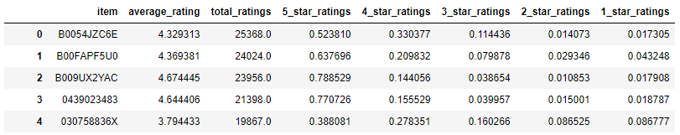
The Data
Data Gathering
Data Transformation
82M reviews of 9.8M products on Amazon.com between 1996-2014.
Collected by Julian McAuley, Professor at UCSD.
There is a newer data, tens of millions more reviews that runs through 2018. I could not gain access to the newer data in time for this project.
Grouped individual reviews by their unique item key.
Create columns for the five star ratings, average rating, and total count.

Slide 8
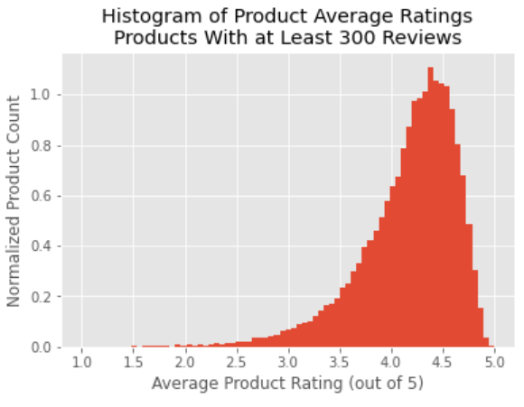
Product Distribution Analysis
Average ratings for products create a well-ordered distribution.
Distribution hardly changes at all for different minimum reviews/product level. Very robust.
Approximates a normal distribution with a super-fat lower tail.

Slide 9
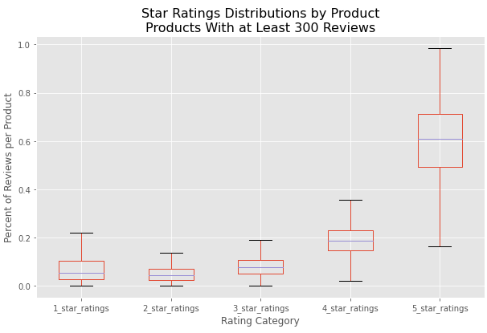
Product Distribution Analysis
Average ratings for products create a well-ordered distribution.
Distribution hardly changes at all for different minimum reviews/product level. Very robust.
Approximates a normal distribution with a super-fat lower tail.

Slide 10
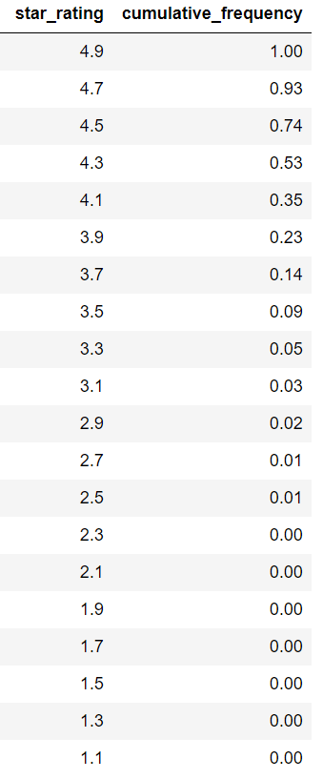
Product Distribution Analysis
Average ratings for products create a well-ordered distribution.
Distribution hardly changes at all for different minimum reviews/product level. Very robust.
Approximates a normal distribution with a super-fat lower tail.

Slide 11
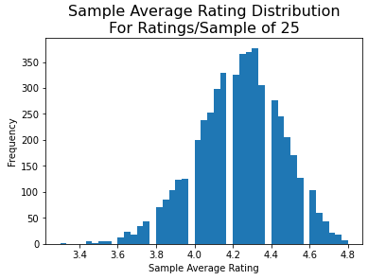
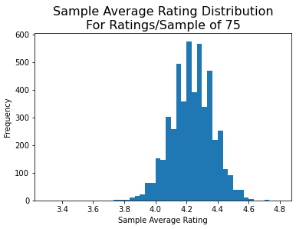
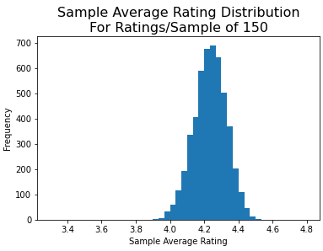
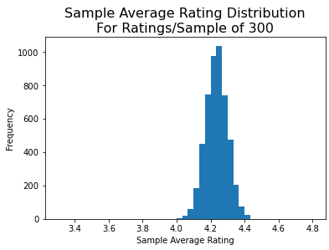
Sample Size Analysis
How many reviews does it take to get a meaningful average for a single product?
Conducted random sampling on a ‘typically’-distributed product with 14,114 reviews with different sample sizes.
Computed 90% confidence intervals for these normal distributions of sample averages.
For useable results, products should have 300+ reviews. Equates to 90% confidence interval of approximately +-0.10 stars or smaller from observed average.
Ended idea of creating a custom scoring system using outlier frequency data, would need an even larger min review count.

Slide 12
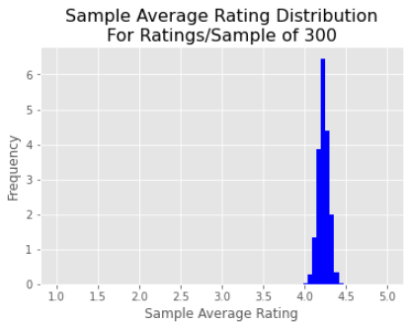
Sample Size Analysis
How many reviews does it take to get a meaningful average for a single product?
Conducted random sampling on a ‘typically’-distributed product with 14,114 reviews with different sample sizes.
Computed 90% confidence intervals for these normal distributions of sample averages.
For useable results, products should have 300+ reviews. Equates to 90% confidence interval of approximately +-0.10 stars or smaller from observed average.
Ended idea of creating a custom scoring system using outlier frequency data, would need an even larger min review count.

Slide 13
Summary of Results
Average score distribution
Sample size cutoff
With this info we can:
For products with more than 300 reviews:
Mean product mean rating: 4.17 Median product mean rating: 4.27 Median 5-Star ratings: 61% Median 1-Star ratings: 5% Calculated cumulative frequency of product average ratings.
300-review minimum for a product will yield results within a reasonable confidence interval of about +-0.10 stars.
Correlate a product’s average rating to a percentile of all products on Amazon.
Determine if this result is statistically meaningful, or subject to extreme variation as more customer reviews are written.

Slide 14
Process
Gather Data
Compile Results
UCSD Professor’s research
Analyze Data
Build Useful Tool!
Inspection, transformation, random sampling, aggregation, visualization
The final product of this project

Slide 15
Construction of Reviews Analysis Tool
1. Generate concise data for tool
2. Decide on desired output
Small, compact datasets and information tables
Non-trivial issue... How to encourage appropriate use of tool by someone who doesn’t fully understand it?
3. Create Python script for Tool
4. Test/debug the script
5. Demonstration!
Incorporate code chunks from my analysis, and new code, into an interactive Python script.
Runs in the terminal. Gets user input. Returns output.

Slide 16




Future Work
Newer dataset
Extend to Services
Analyze New Domains
Increased Utility
Accelerated change (COVID). Consumer behavior. Wider Demographic. Online Shopping.
Analyzed products, now try services. Yelp is a top business review website. Has rich dataset available for academic use.
Do these results extend more generally to sites with product/services reviews?
Go from descriptive to prescriptive using NLP for positive and negative individual reviews.

Slide 17
Questions? Answers.

